Slide 1
MetroHealth MyChart
CYC Elective
4-24-12

Slide 2
With MyChart You Can…
Request & cancel appointments.
View your health summary and histories.
Request prescription renewals.
Communicate with your medical care team.
Access health information.

Slide 3
MetroHealth MyChart is…
Free
MetroHealth information only.
Private – only one individual per account.
Not for emergencies.
Notes:
- MetroHealth MyChart does not provide access to records from other health systems.
Only one individual per account but patients can give proxy access to a parent, spouse, adult child or a caregiver. We’ll show you how to do so in a few minutes.
In situations where you need an immediate assistance, call 911.

Slide 4
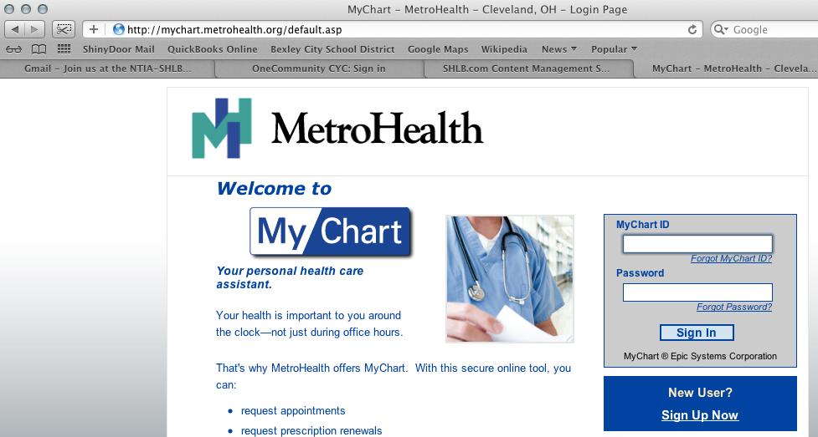
Log-In to MyChart
Notes:
If you’ve used MyChart in the past, enter your MyChart ID and your password. If you have not used MyChart yet but you have an access code from your doctor, click Sign Up Now. http://mychart.metrohealth.org and http://metrohealth.org/mychart both take you to the same page where you can log in.

Slide 5
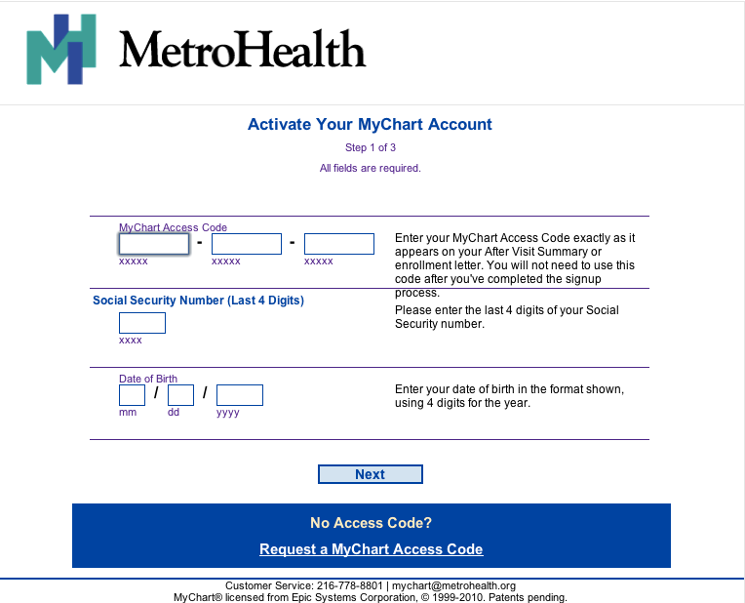
Creating an Account
Notes:
This is what you will see if you click Sign Up now. You need your access code to create an account. If do not have an access code, click on Reqeust a MyChart Access Code. You WILL need an email address to sign up for an account.

Slide 6
Access Code
If you request a code online, your code will be mailed to you within 2 weeks.
If you request a code from your doctor’s office you can pick it up from your doctor’s office immediately.
Access code is also printed on your After Visit Summary when you visit your doctor.
Notes:
To request a code online https://mychart.metrohealth.org/en-US/OnlineReg/default.aspx

Slide 7
Log-In Troubleshooting
Access codes are valid for 60 days. Once you use your code you will not need it again.
If your code expires before you use it, you can request another code.
Customer Service - 216-778-8801
Notes:
If you have had your code for more than 60 days, it will not work. You’ll need to request a new code.
The code only works once, then you use your ID and password to access MyChart.
Problems with IDs or passwords? Call customer service.

Slide 8
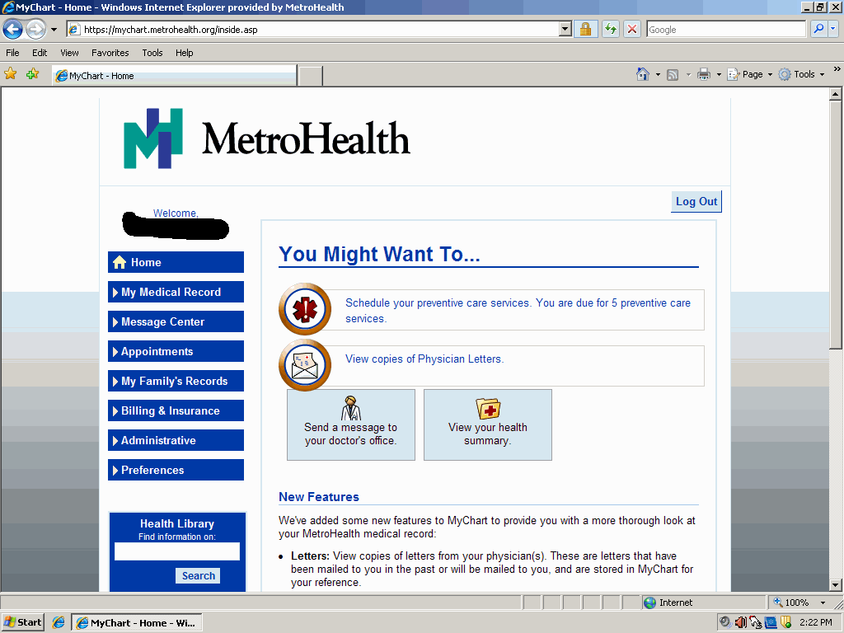
MyChart HomePage
Notes:
After you log in, you’ll see something similar to this. MyChart recommends preventative care services. Keep in mind these preventative care services are automated. If you have had any of this done in other health systems, MyChart is unaware. You will also receive emails from MetroHealth when new information is posted to your account.

Slide 9
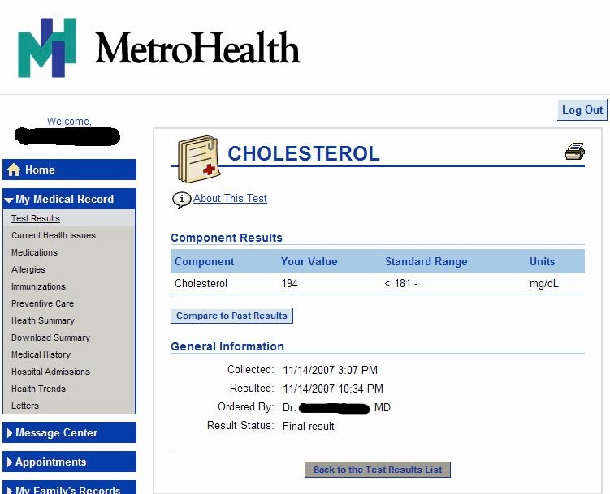
Test Results
Notes:
When you click on test results, you see any test results that have been uploaded to MyChart.

Slide 10
Test Results on MyChart
Available within 1 day to 3 weeks.
Not all test results are available on MyChart.
If you have a question about your test results, send a message to your doctor. Be specific.
Notes:
Doctors decide which test results are available on MyChart. Plus, some test results that are sensitive are not posted.
The more specific the question asked, the more likely the patient will receive a response with helpful information rather than a request for clarification of the question.

Slide 11
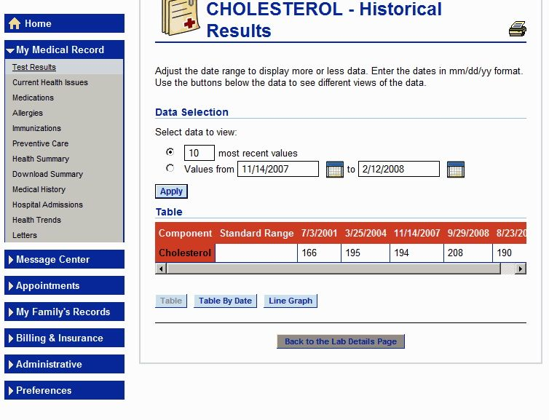
Compare Test Results
Notes:
If you have been a MetroHealth patient for multiple years, you can see and compare the test results.

Slide 12
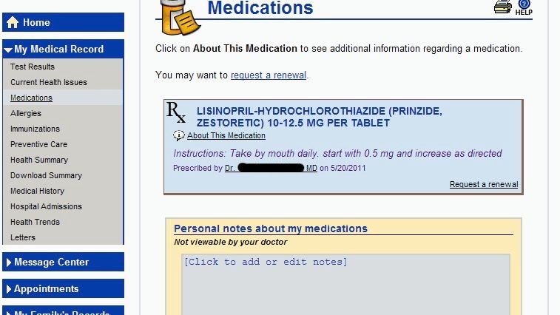
Medications
Notes:
Under My Medical Record is Medications. If you click on Medications you will see all meds prescribed by MetroHealth doctors including the instructions for how to take them. You can request a renewal from this page or by clicking on Request Rx Renewal under Message Center.

Slide 13
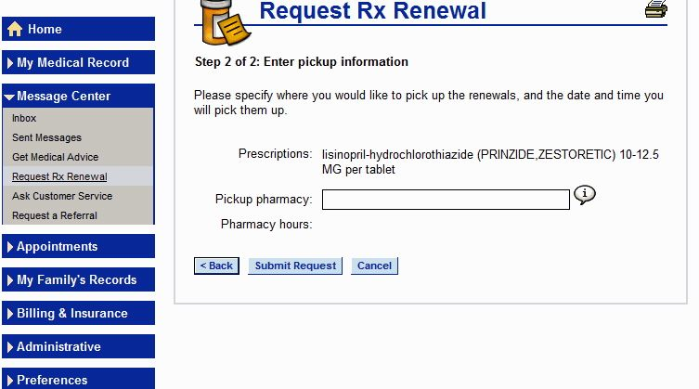
Prescription Refill
Notes:
Regardless of which link you click on for prescription refill, this is what you’ll see. You enter where and when you would like to pick up your prescription renewal. In the Pickup pharmacy box you type in the name and location of your pharmacy. You will receive confirmation through MyChart that your prescription is ready to be picked up.

Slide 14
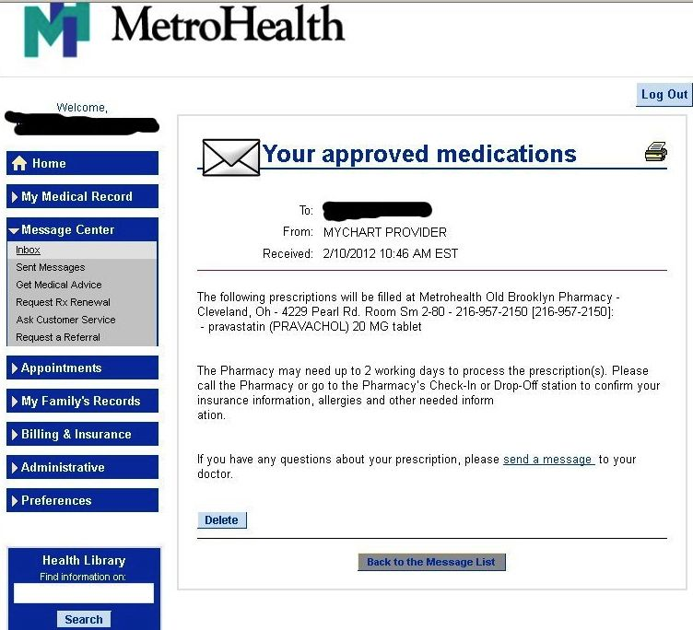
Prescription Confirmation
Notes:
On your homepage and in Message Center you’ll find a confirmation that your prescription has been filled and at what pharmacy you can pick it up. (Remember, you will have identified this pharmacy when you requested the prescription. Do look at the pharmacy name and location to make sure your prescription was sent to the correct pharmacy.)

Slide 15
Get Medical Advice
Visit follow-up Question
Prescription Question (not renewal)
Test Results Question
Non-Urgent Medical Question
DO NOT USE MYCHART FOR EMERGENCIES!
Notes:
You can use MyChart to send one of your doctors a question. The time for a reply varies. Important that you not use MyChart in emergency situations!

Slide 16
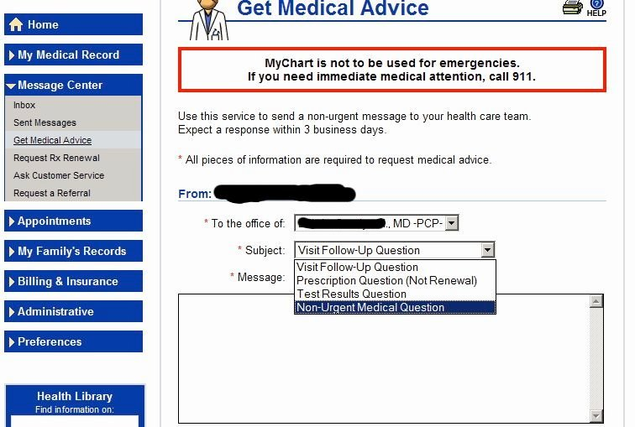
Get Medical Advice
Notes:
This is what the screen will look like when you have clicked on Get Medical Advice. Be specific with your email message. Consider the questions the doctor might ask you. The more specific you are, the more likely you are to get a response that has an answer rather than a response that requests more information.
Only request information regarding yourself from your MyChart account. Asking about a child or someone else from your account will result in this information being IN YOUR account and could lead to confusion.

Slide 17
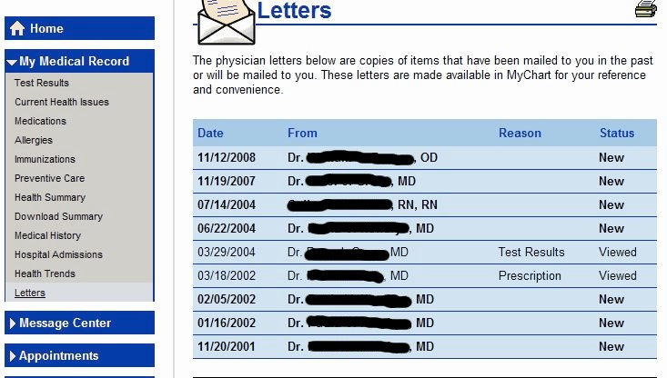
Doctors’ Letters
Notes:
At the bottom of My Medical Record is a link for Letters. Here you will find copies of mailed correspondence from your doctor.

Slide 18
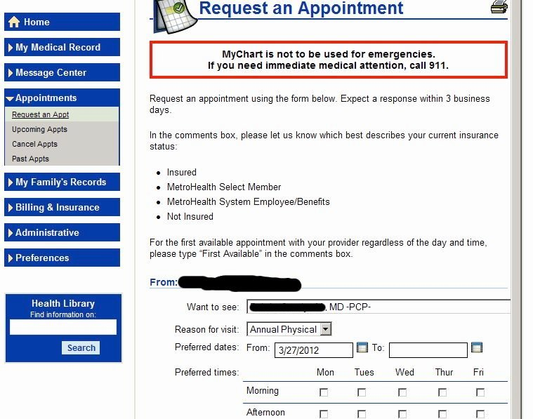
Appointments
Notes:
Your first option under Appointments is Request an Appointment. The more options you provide, the more likely your doctor will confirm one of your preferred times. You will receive a confirmation within MyChart of your appointment day and time. You will see it on your homepage when you log in. Be sure to note your insurance status in the comment box as requested on this page.

Slide 19
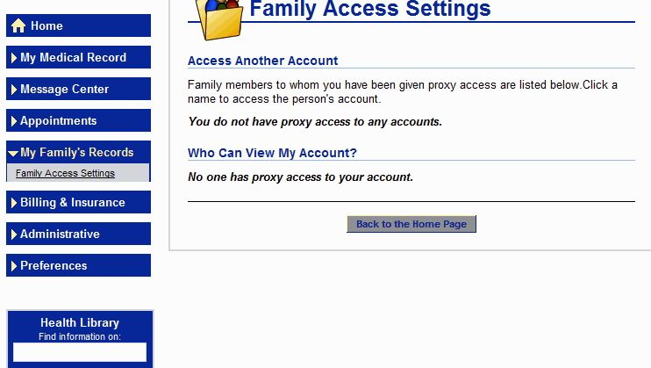
Access to Family Records
Notes:
Under My Family’s Records you can click on Family Access Settings to see any proxy access you have or someone else has of your account.

Slide 20
Access to Family Records
MyChart calls this “proxy access”.
To request proxy access, you must complete a Proxy Authorization form. http://mychart.metrohealth.org/en-us/MyChartProxyAccessPacket.pdf
Submit form in person to doctor’s office or MetroHealth Medical Records Department.
Notes:
The form must be submitted in person so that your identity can be verified. Non-MetroHealth patients can be given proxy access. They just need to create a MetroHealth MyChart account. Talk to your doctor about getting the person you would like to have proxy access an access code needed to create an account.

Slide 21
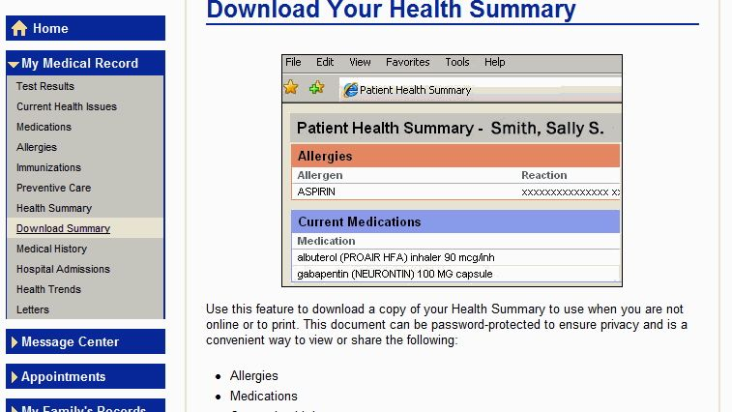
Download Summary
Notes:
Under My Medical Record, you have the options to view your Health Summary. Click Health Summary. You also have the option to Download your Health Summary. Click Download Summary. You are downloading a file. You can print the file and give to spouse, children, parents, etc.

Slide 22
You CANNOT Edit on MyChart:
Address or phone number
Medical information.
Contact your doctor to change this information.

Slide 23
You Can Edit on MyChart
Your Email Address
Your MyChart password

Slide 24
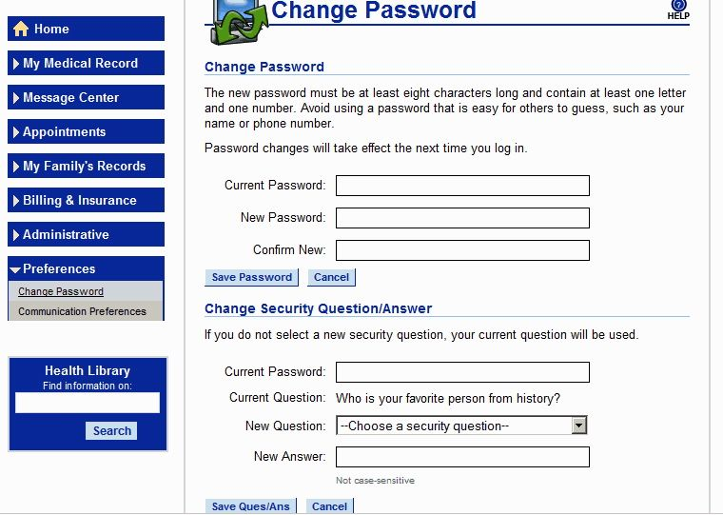
Change Password
Notes:
Under Preferences, click on Change Password. Be sure to write your new password down someplace where you will be able to find it!

Slide 25
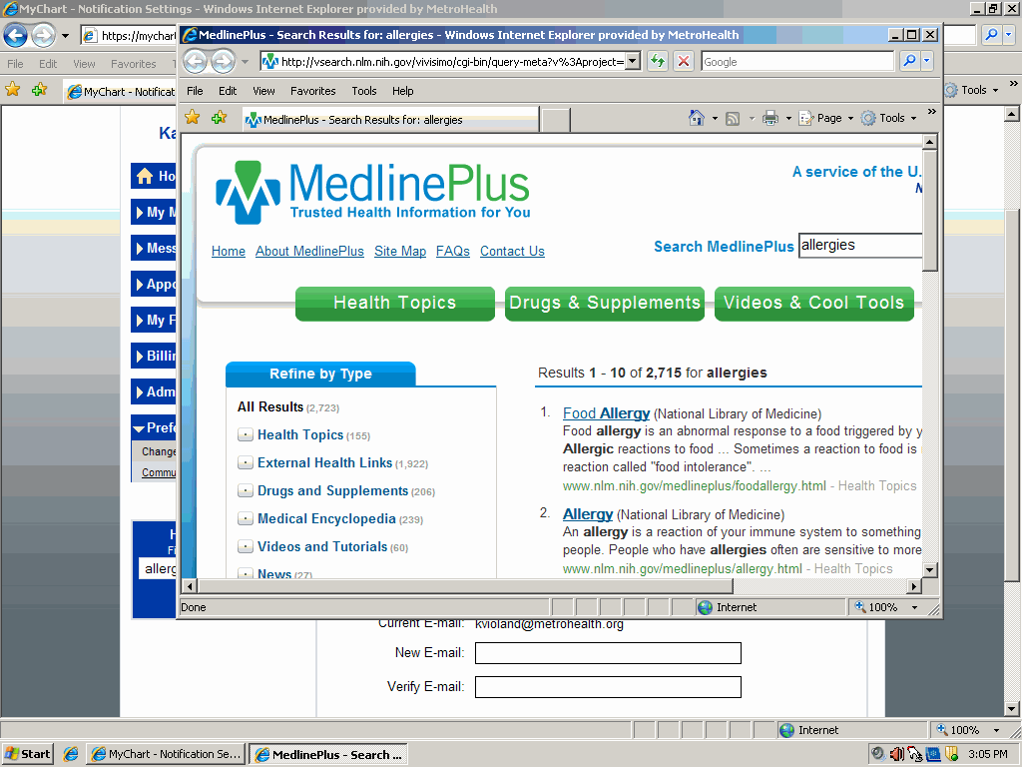
Health Information
Notes:
In many sections you will find drug name and health conditions are hyperlinked (meaning if you click on them the link will take you to another page). These links take you to MedlinePlus, a health information website chosen by MetroHealth.

Slide 26
MyChart Help
Each MyChart page has a help icon in the top right. Clicking on it provides help for the particular page you are on.
FAQ (Frequently Asked Questions) link is available on https://mychart.metrohealth.org/

Slide 27
Sources
This module was created cooperatively by MetroHealth and Connect Your Community, a project of OneCommunity, funded by the federal Broadband Technology Opportunities Program.

Slide 28
Creative Commons License
This work is licensed under the Creative Commons Attribution 3.0 Unported License. To view a copy of this license, visit http://creativecommons.org/licenses/by/3.0

